Slide 1
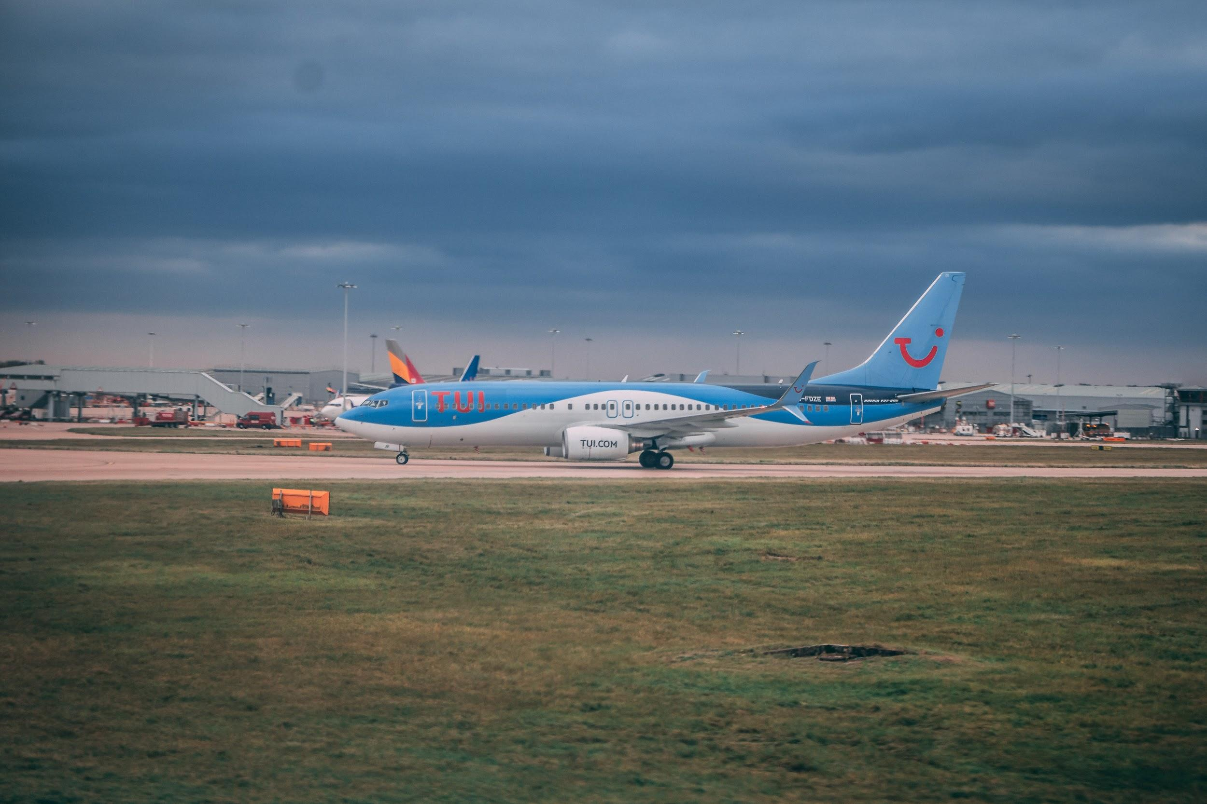

Fleet Mix Model Parameter Generator
Coffee & Coding - 26th of June 2019
A description of the R Script using CAA movement data and IBA aircraft inventory to derive model parameters.

Slide 2

No Agenda ( Welcome to C&C)
Interactive session (interrupt at any time)
Fingers crossed for R Studio not being slow
I have alternatives

Slide 3
Fleet Mix Model and use of R Studio
This C&C isn't about the aviation model or the fleet mix model. It is about the work carried out to ‘comprehensively review’ parameters that form the FMM .
I will summarise the use of various independent datasets to produce parameters that will form the basis of the next iteration of the fleet mix model.
I saw this as a unique opportunity to fuse together information on aircraft movements (CAA records) with third party data on aircraft age (IBA aircraft inventory). The resulting dataset has been crucial in understanding the age makeup of these movements and in devising an understanding of how the fleet will transform in the future. The only mechanism dictating fleet renewal in our methodology is retirement and replacement with a newer aircraft type.
One of the main reasons for using R was its functionality in dealing with large datasets which MS office tools don’t perform as effectively.
I will talk about and run the script which is split across several steps (some optional) which need to be followed sequentially. The code is commented at all relevant locations.
All the assumptions were made in February 2019 and it is likely that they will have changed when this model is put into use. A proportionate and targeted approach should be undertaken in case further changes are deemed necessary. The methodology and the process can be replicated with relative ease whenever newer data becomes available.

Slide 4
Project details
Project objective - To carry out a comprehensive review of inputs and parameters underpinning the fleet mix model (FMM) for inclusion in next aviation update.
ATMs forming base year data (2017)
Age distribution by carrier type
Aircraft retirement age
Aircraft supply pool by segment
The updated fleet mix model
The process followed after fusing together information on aircraft movements (CAA) with IBA aircraft inventory
The underlying database running the FMM. This is the base year fleet age distribution for all air transport movements by service type
The main mechanism causing fleet renewal, i.e. retirement and replacement.
In year proportion of expected aircraft productions per segment
A development version is being tested
1
2
3
4
5
Notes:
Many of our assumptions have been part of the model since the 1990s and needed to be refreshed as part of this project
The best way to understand the update is the four sets of inputs go inside the fleet mix model.
In the interest of time - I will focus on items 1 and 2 in this presentation

Slide 5
Datasets and lookups available
Movement data [CAA] - Individual aircraft movements in and out of UK reporting airports with detail on date, time, registration, aircraft name, type, operator, origin-destination, passengers, available seat and freight mass carried. This is provided to DfT by the CAA and made available on a calendar year basis. For this project it is the calendar year of 2017.
Order backlog data [IBA iQ] - An order backlog repository composed of ordered aircraft model detail, operator detail, engine model detail, delivery date and current status of the order.
Aircraft lookup [Internal] - A lookup of aircraft name (as used in CAA movement data), IATA code (as used in FMM), aircraft haul usage and production status.
Fleet inventory [IBA iQ] - A paid for data subscription composed of an inventory of aircraft registrations with associated information such as model type, manufacturer, operator/owner details, manufacture year, seating configuration and status (where applicable)
Worldzone lookup [Internal] - A lookup of airport name and the three digit SPASM (aviation model) zone
Notes:
CAA dataset is owned by CAA.

Slide 6
Code structure (steps)
0
1
2
3
4
5
Global declarations
Input files
Pre processing Review
Processing
Post processing Review
Prepare data
File locations, libraries, input year, OECD_countries etc..
Import files and lookups into R environment
Rationalisation and Harmonization
Removed duplicates
Relevant data from previous step are consolidated into dataframes and findings saved in single xlsx file
Show the file - CAA_ATMs, IBA_Fleets and IBA_Orders
Processing data by merging, cutting and applying heuristics
Segmentation rules SCLFO and seat class
Remove irrelevant or noisy records
Relevant data from previous step are consolidated into dataframes and findings saved in a single xlsx file
Show the file - PostProcessedData
Prepare data for FMM and output into csv
Show the file - FMM_2017 inputs ATM age distribution
Notes:
Again – this presentation is not about the data but about the R code.
How would you do it differently?

Slide 7
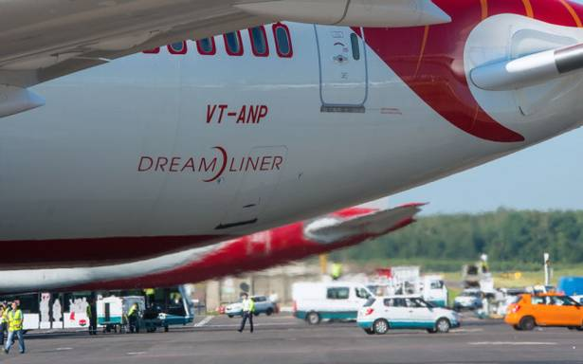
Data matching - a bit of context
The 2017 CAA movement data had 2.2m records for arrivals and departures at 46 UK reporting airports
The IBA fleet inventory has 28k (after cleaning) unique aircraft registrations representing the commercial aviation market across the world (active as of 2017)
Quiz time (as of 2017) - closest one gets a treat
Largest airline (AOC) in the world operates how many aircraft?
What is the largest non US airline in terms of fleet?
What is the fleet count of British Airways ? Ryanair? and Easyjet?

Slide 8

Data processing (summarised) - code
Routine to allocate a movement into SCLFO
# Rule 1 - If service_type is "Passenger", the movement is classed as S (Schedule)
# Rule 2 - If the aoc_holder_name is one of - "RYANAIR", "EASYJET AIRLINE COMPANY LTD", "EASYJET SWITZERLAND“ or "JET2.COM LTD" - Then movement is reclassed as L (Low Cost)
# Rule 3 - if operation_type is "Charter" , then movement is reclassed as C (Charter)
# Rule 4 - if service_type is either "Cargo Only" or "Transit Cargo" , then movement is reclassed as F (Freighter)
# Rule 5 - if operation_type is "Government Charter" , then movement is reclassed as O (Other)
# Rule 6 - if pax_terminal_total & pax_transit_total & cargo_weight_kg are all zero, then movement is reclassed as O (Other)
# Rule 7- if the lastnext airport is in the UK and Chartered, it is classed as O
# Rule 8 - if the flight movement is S or L and has either reporting or last nextairport SPASM zone as 599, it is classed as O (Other)
Routine to calculate seat class from available seats
If value is < = 1 then seat class is 0
If value is > 1 and < = 70 then seat class is 1
If value is > 70 and < = 150 then seat class is 2
If value is > 150 and < = 250 then seat class is 3
If value is > 250 and < = 350 then seat class is 4
If value is > than 350 and < = 500 then seat class is 5
If value is > 500 then seat class is 6
Notes:
Two major routines to allocate all these records into buckets was carried out
Which are essentially collection of if statements
A FMM descriptor of aircraft service based on carrier business model
Sch – for Scheduled legacy carriers
Ch – for Charter services
NFC – No Frills Carriers or UK Low Cost Carriers which are Easyjet, Ryanair and Jet2.com

Slide 9

Data cleaning
Cleaned out 50k reported at non modelled UK airports
Cleaned out 110k are arriving to or departing from non modelled UK airports (~50k of them are OIL RIGS) (O)
Cleaned out ~500 records that were arriving to or departing from UNKNOWN airports
Cleaned out 50k records are for Cargo only or Transit Cargo (F)
Cleaned out ~500 are Government Charter (O)
Cleaned out 12k records with incomplete information about seating, aircraft type, unmatched registrations or with aircraft types occurring less than 100 times in the UK.
A total of ~220k records were cleaned out resulting in …
Notes:
Figures rounded

Slide 10
Dataset to use for 2017 fleet modelling parameter review
Seat Class | Schedule | Charter | Low Cost
Class 1 (upto 70 seats) | 66.2k | 1.3k
Class 2 (71-150 seats) | 531k | 3.9k | 16.5k
Class 3 (151-250 seats) | 509k | 52k | 647.6k
Class 4 (251-350 seats) | 133k | 7.4k | .5k
Class 5 (351-500 seats) | 31k
Class 6 (500+ seats) | 11.4k
Total ATMs | 1.3m | 60k | 670k
All these ~2.01m movements were carried out by 6.5k unique aircraft registrations made up of 46 IATA (aircraft) codes.

Slide 11
Code demo
Q&A

